Slide 1




Software testing
Sensor Data Aggregation and Visualization System
Nischal Vooda (Z-1985022)
Niharika Prathi(Z-1981037)
Hemanth Chimakurthi(Z-1981900)

Slide 2

FUNCTIONAL REQUIREMENTS
BACKEND ARCHITECTURE
BME680 Sensors:
Multiple BME680 sensors are connected to Raspberry Pi Pico via wires.
Pico Network Connectivity:
Pico is connected to a network.
The LED indicator is on when Pico is successfully connected to the network.
Data structures used for Storage:
Utilizes I2C protocol to retrieve data from connected sensors.
Data is stored in Pico's memory.
The FIFO queue is used as a data structure for efficient data storage.
Data Processing:
Pico performs data processing internally.
Calculates MAX value and MEAN of the collected data.
API Functionality:
PICO acts as an API endpoint.
Responds with data in JSON format when queried.

Slide 3
FUNCTIONAL REQUIREMENTS
FRONT END ARCHITECTURE
Web Server Using Flask:
Flask employed as the web server
User Interaction:
User-triggered data update button on the front end.
Displayed Information:
Current Sensor Data, Max, and Mean Values of the past 30 seconds.
Total number of connected Picos.
Status of each Pico's availability.
Redundancy Handling:
Data is pulled from the backup Pico if the main Pico is unavailable.
If all Picos are down, values are set to zero.
User Preferences:
Toggle buttons for Max Values and Mean Values.
Allows users to turn off data retrieval if not interested.

Slide 4

NON-FUNCTIONAL REQUIREMENTS
Reliability:
Implemented robust exception handling to prevent errors and website crashes. In the event of all Picos being down, the system displays 0 instead of random errors for a more user-friendly experience.
Performance:
Achieved fast response times (less than 1 sec) for data retrieval upon clicking the "Update Data" button. Prioritized website speed and efficiency for a seamless user experience.
Maintainability:
Utilized Git for version control and code storage.
It is easy to maintain and update the changes whenever necessary in the project.
Efficiency:
Processed max and mean values of sensor data within the Pico for efficient resource utilization.we ensured the Pico's resources were utilized effectively.
Scalability:
Started with two BME680 sensors, but was easily scalable based on traffic and requirements. Flask web server seamlessly adjusts to an increasing number of connected Picos, ensuring real-time updates

Slide 5
NON-FUNCTIONAL REQUIREMENTS
Availability:
Implemented redundancy measures for 98% of website availability.
Even if one Pico fails, the server retrieves data from another, ensuring uninterrupted service.
Reusability:
Code is broken down into small, modular functions/methods for easy reuse.
Each function/method has a single responsibility, promoting reusability and maintainability.
Security:
Implemented custom key-based encryption to secure data transmitted over HTTP.
Ensured client-side decryption for enhanced security measures against potential data breaches.
Correctness:
The website functions as expected based on project requirements.
Notes:
hioii sadfhl;

Slide 6
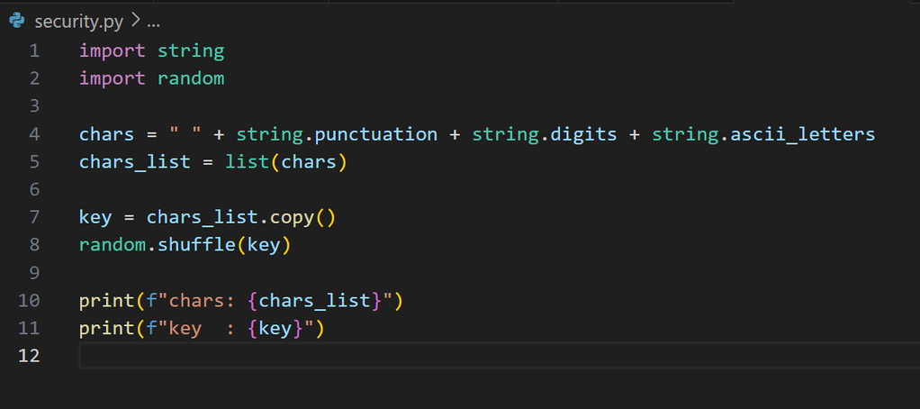
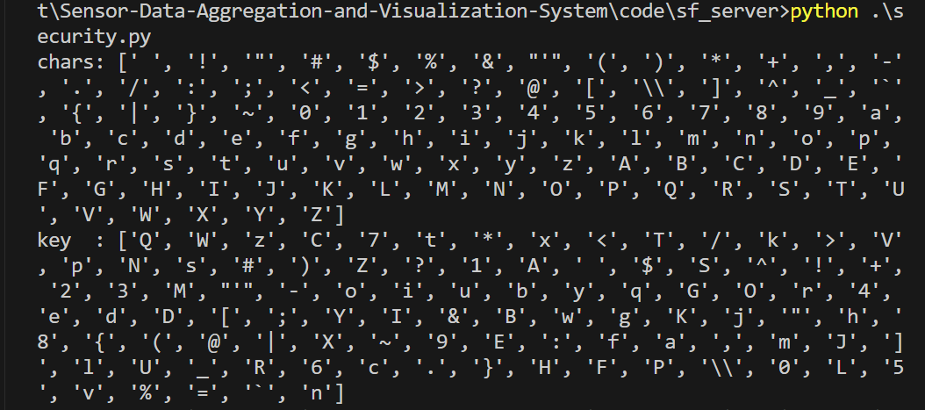
IMPLEMENTATION
Observer-Design pattern
When the user clicks on the "Update data" button server pulls sensor data from PICO to ensure efficient power management and battery conservation
Encryption and decryption
Using Python we created a custom key that is saved in PICO W and webserver. using this key the data is encrypted in PICO and decrypted in webserver before displaying the data. this helps to overcome man in the middle attack

Slide 7



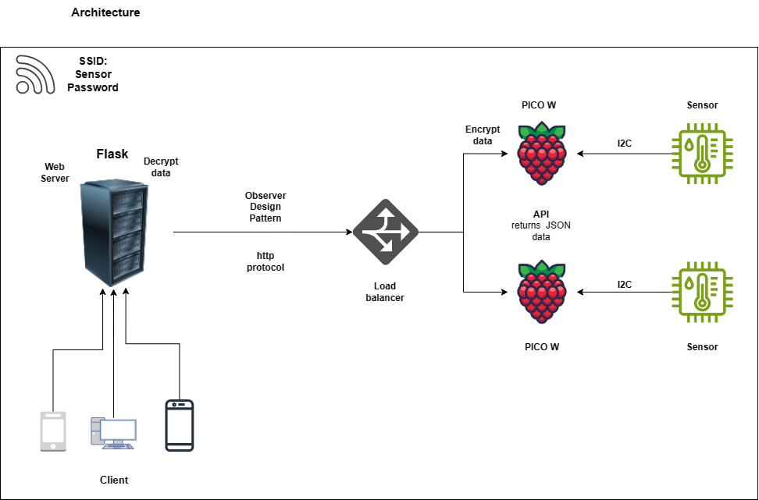
HIGH-LEVEL DESIGN

Slide 8
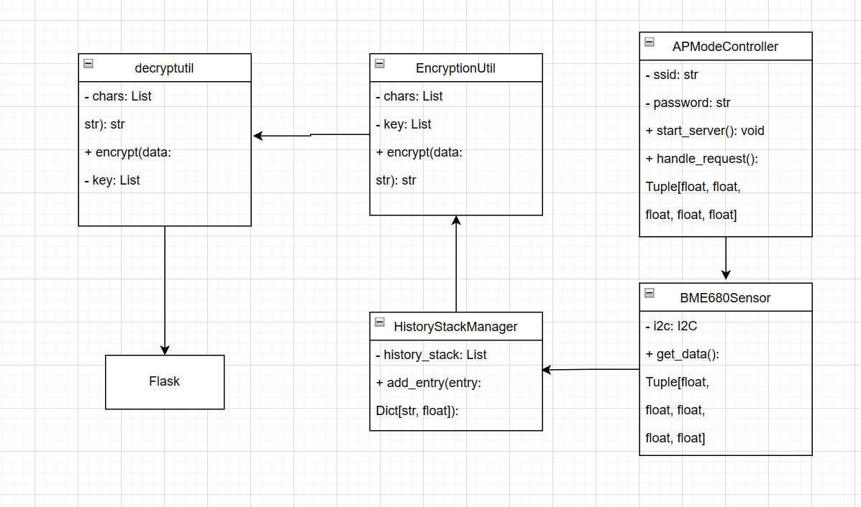
Class diagram

Slide 9

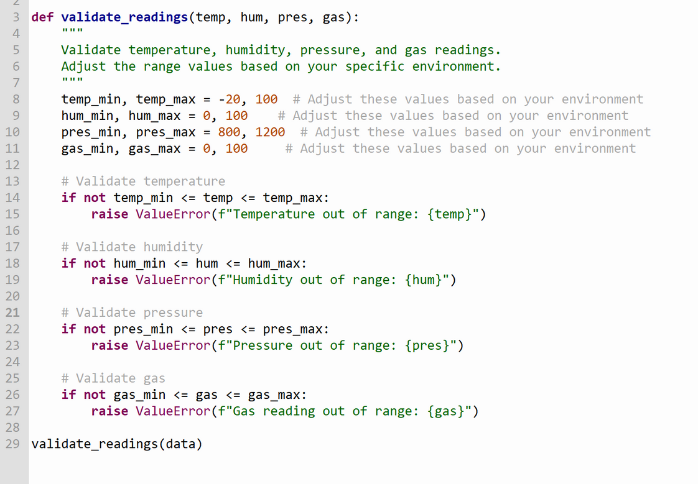
TESTING
Unit Testing
Testing Reading
To ensure that the temperature, humidity, pressure, and gas readings are within expected ranges.
We add validation checks for all readings within the expected ranges.

Slide 10
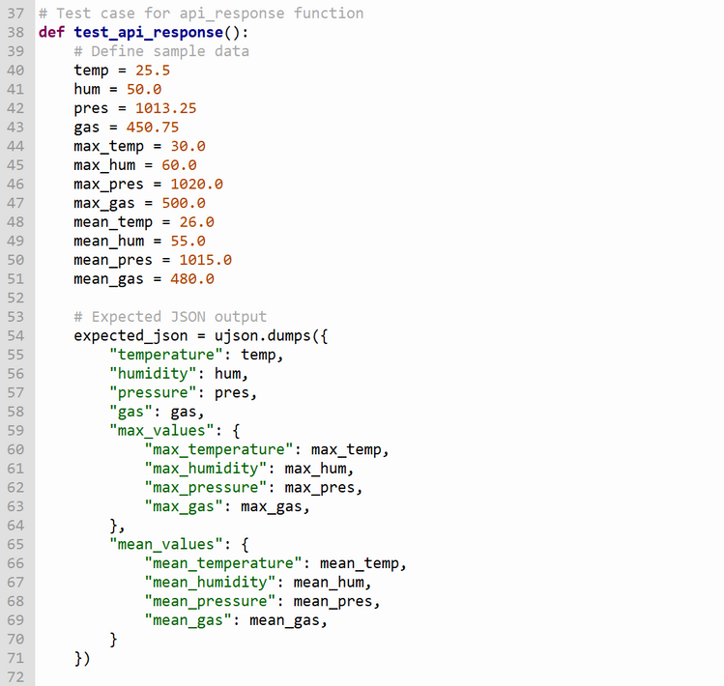
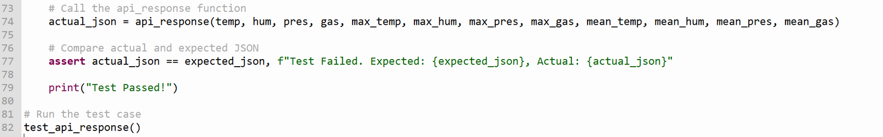
TESTING
Unit Testing
API Response Testing
Test the api_response function to ensure it formats the data into the expected JSON format.
Verify that the JSON keys and structure are correct.

Slide 11
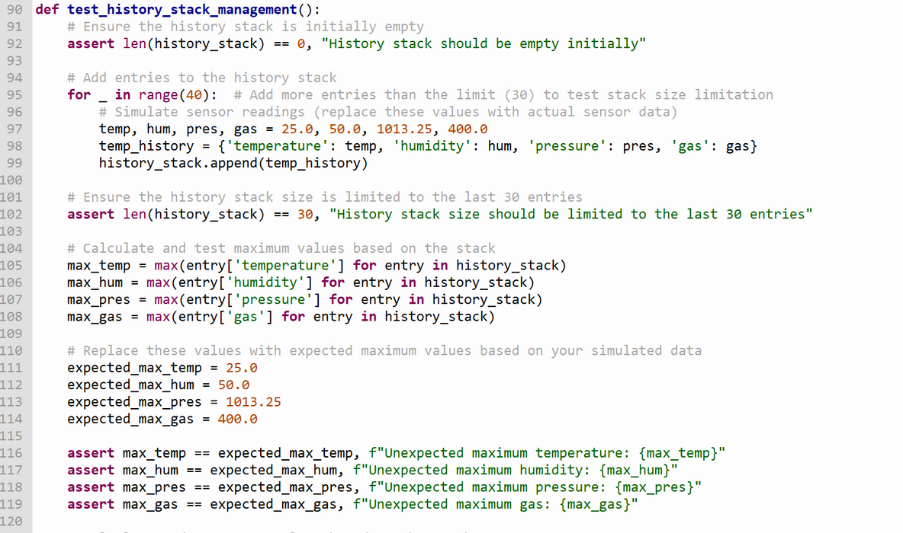
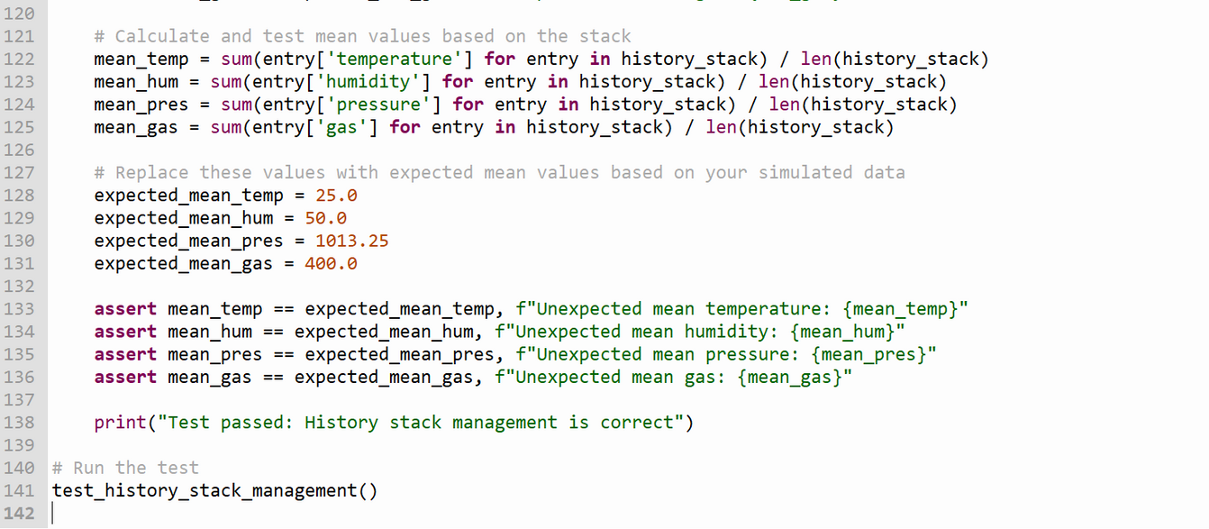
TESTING
Unit Testing
History queue testing
Test that the history queue is correctly storing and limiting the number of entries to 30.
Verify that the maximum and mean values are calculated correctly based on the queue.

Slide 12
TESTING
Acceptance Testing
Alpha testing
During alpha testing, the website was thoroughly evaluated to ensure proper functionality. Satisfied with the results, we confirmed that all features operated smoothly, meeting initial development expectations.

Slide 13
TESTING
Acceptance Testing
Beta Testing
Website shared with peers for feedback during beta testing.
The feedback from the user:
The website is considered user-friendly and smoothly functioning.
Users understand the website's purpose and functionality with minimal guidance.
Color Contrast Feedback:
Some users suggest that color contrast could be improved.
Recommendation to implement a lighter theme for better visual appeal.
Data Retrieval Feedback:
Users sometimes feel the need for only current data.
Suggestion to provide an option to avoid retrieving max and mean values when not needed.

Slide 14
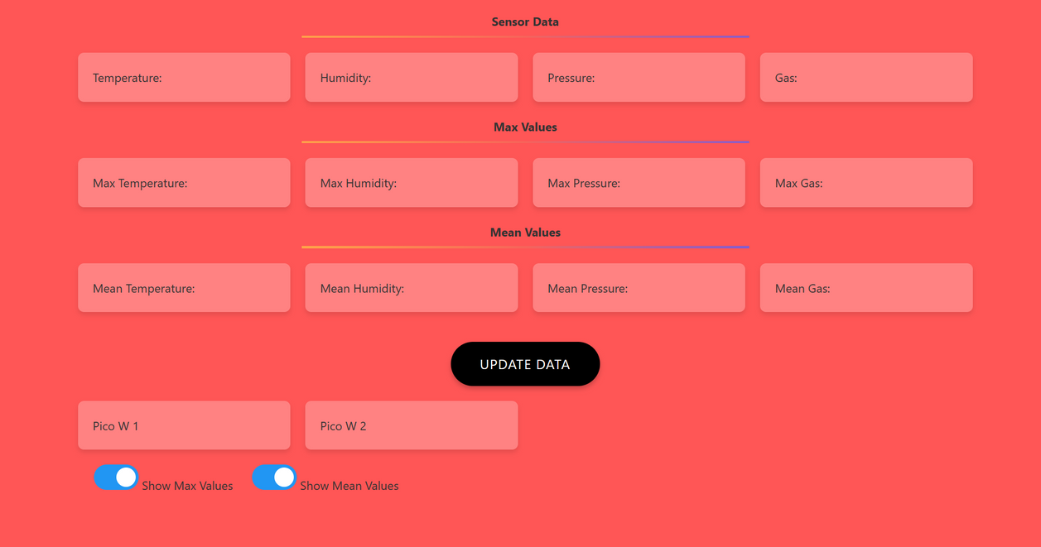
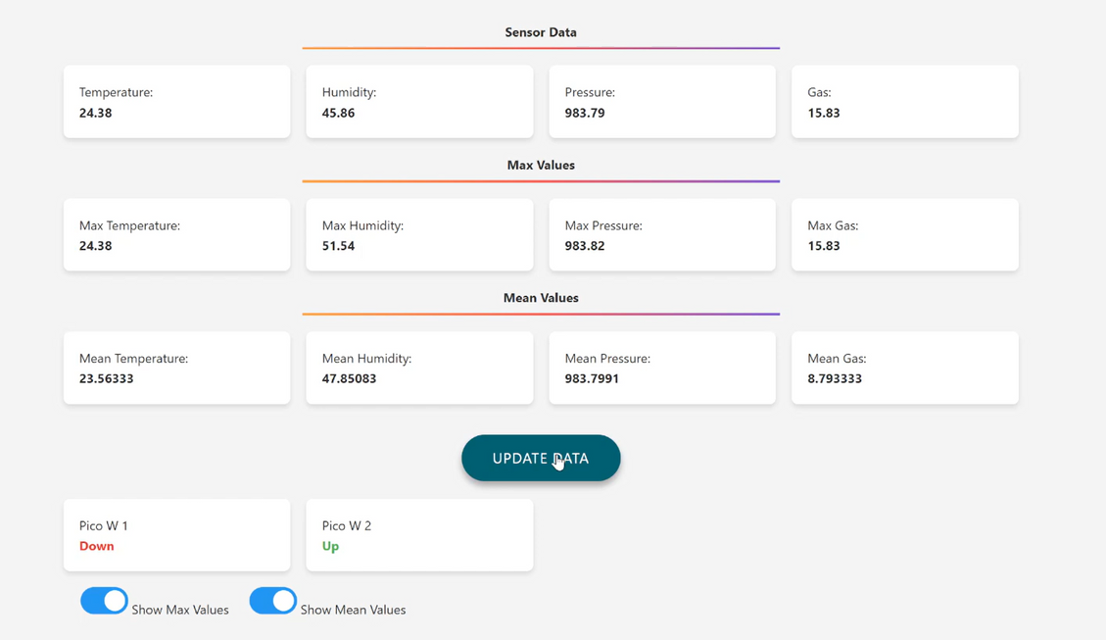
TESTING
Acceptance Testing
Beta Testing
As the user suggested we changed the odd theme to a good light theme
Before After

Slide 15
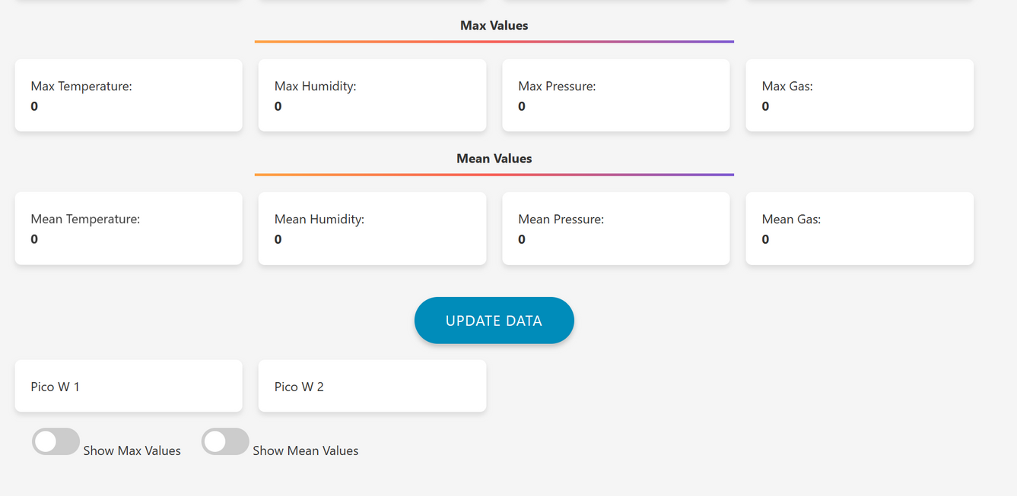
TESTING
Acceptance Testing
Beta Testing
As the user suggested we added two switches for Max Values and Mean Values so if the user feels like there is no need to retrieve this data he or she can turn it off also this will improve the website quality

Slide 16



DEMO
DEMO

Slide 17
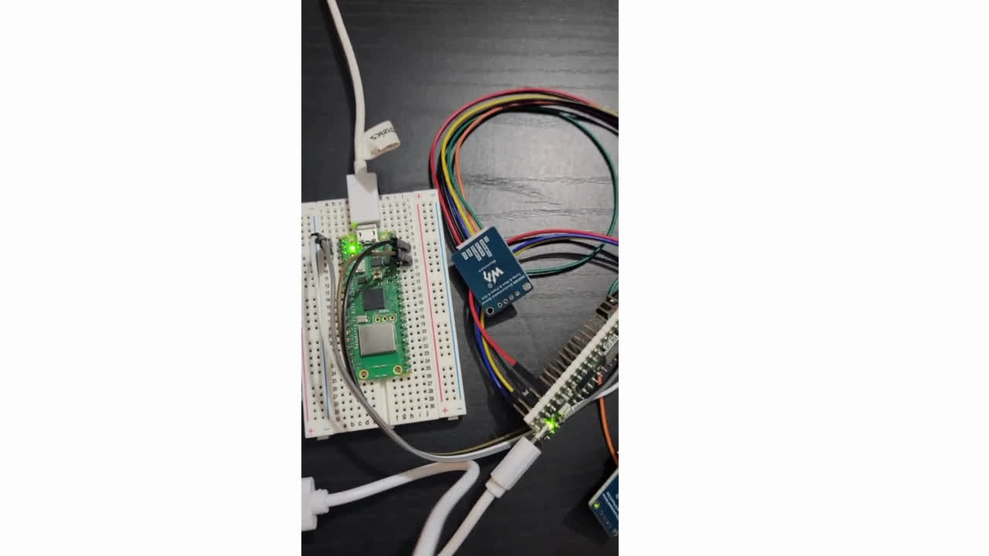

Slide 18

Q&A
Q & A

Slide 19
ThankYou!!

